Slide 1
Graph Embedding Tutorial
Maosen Zhang

Slide 2
Graph Analysis
Modeling the interactions between entities
Tasks:
Node classification
Link Prediction: Predicting missing links or links that are likely to occur in the future
Clustering: Find subsets of similar nodes and group them together
Visualization
Operation:
On the original graph adjacency matrix
On a derived vector space

Slide 3
Challenges of Graph Embedding
Choice of property
Choosing the property of the graph which the embedding should preserve
Scalability
Most real networks are large and contain millions of nodes and edges
Dimensionality of the embedding
higher number of dimensions may increase the reconstruction precision but will have high time and space complexity
Notes:
property

Slide 4
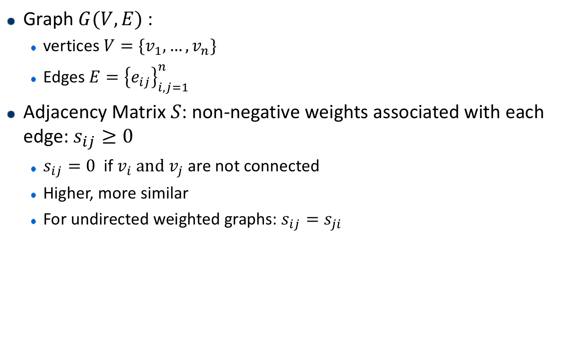
Definitions
Graph$G(V,E)$ :
vertices $V=\{v_{1},…, v_{n}\}$
Edges $E={\left\{e_{ij}\right\}}_{i,j=1}^{n}$
Adjacency Matrix $S$: non-negative weights associated with each edge: $s_{ij}≥0$
$s_{ij}=0$if $v_{i}$and $v_{j}$ are not connected
Higher, more similar
For undirected weighted graphs: $s_{ij}=s_{ji}$
Notes:
顶点 vertice
邻近度 proximity
从结点到向量的映射

Slide 5
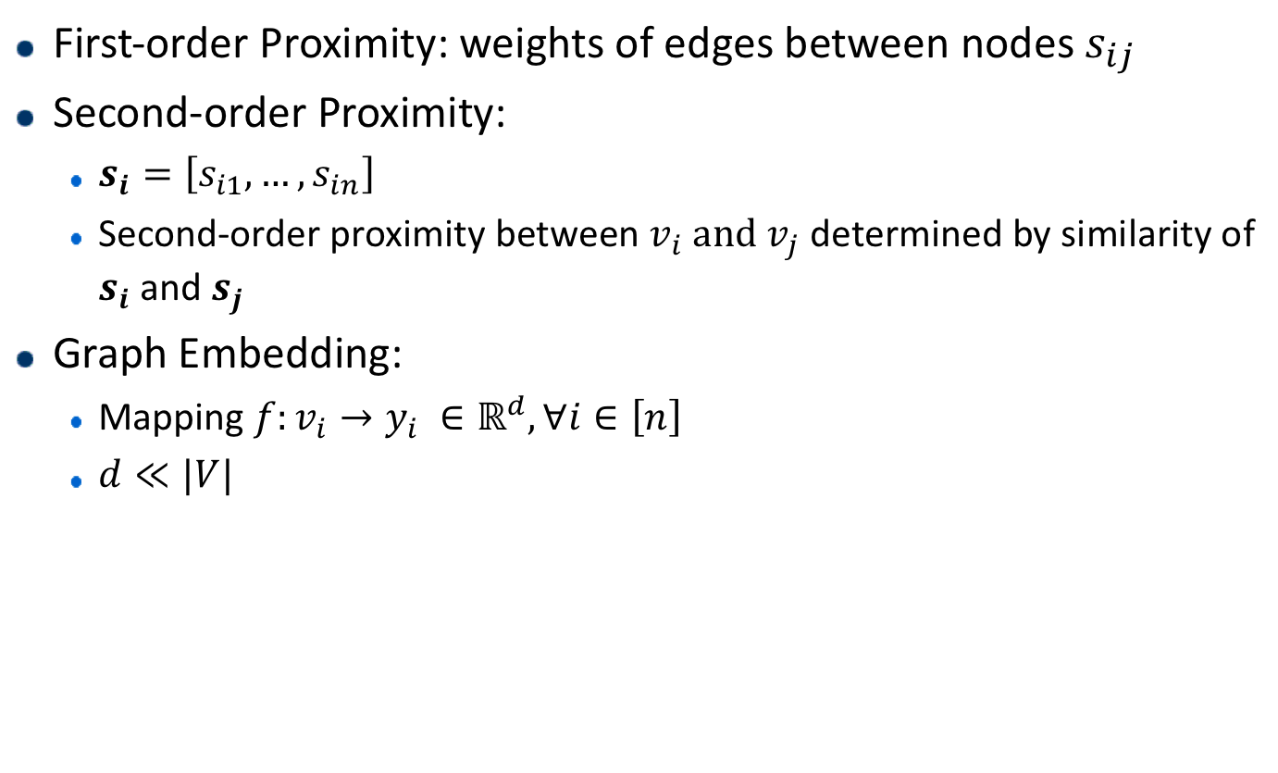
Definitions
First-order Proximity: weights of edges between nodes $s_{ij}$
Second-order Proximity:
$s_{i}=\left[s_{i1}, …,s_{in}\right]$
Second-order proximity between $v_{i}$and $v_{j}$ determined by similarity of $s_{i}$ and $s_{j}$
Graph Embedding:
Mapping $f:v_{i}→y_{i} ∈ℝ^{d}, ∀i∈\left[n\right]$
$d≪|V|$
Notes:
顶点 vertice
邻近度 proximity
从结点到向量的映射

Slide 6
Approaches
Factorization based methods
Random walk based methods
Deep learning based methods
Notes:
基于矩阵分解

Slide 7
Factorization based Methods
Represent the connections between nodes in the form of matrix
Factorize the matrix to obtain the embedding
Matrices:
Adjacency matrix
Laplacian matrix
Node transition probability matrix
Katz similarity matrix
Factorization approaches:
positive semidefinite (e.g. the Laplacian matrix): eigenvalue decomposition
unstructured matrices: gradient descent methods
Notes:
基于矩阵分解
positive semidefinite：半正定矩阵
实对称矩阵A称为半正定的，如果二次型X'AX半正定，即对于任意不为0的实列向量X，都有X'AX≥0
Eigenvalue:特征值

Slide 8
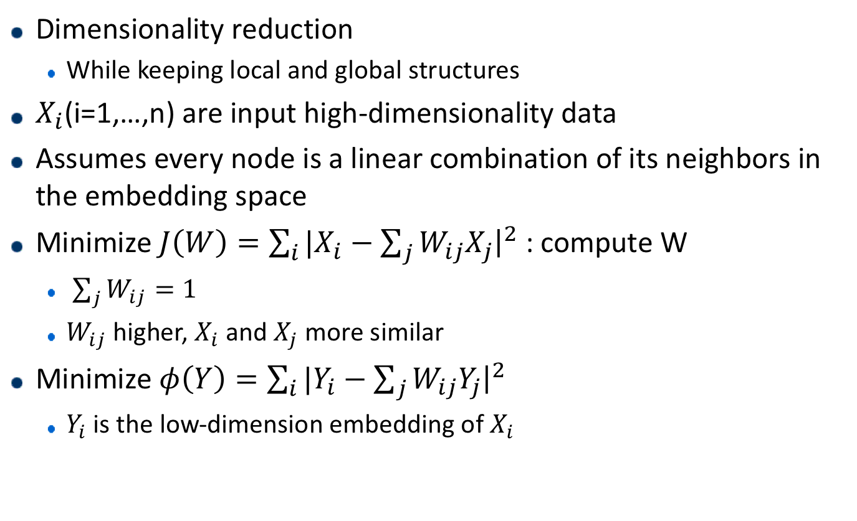
Locally Linear Embedding (LLE)
Dimensionality reduction
While keeping local and global structures
$X_{i}$(i=1,…,n) are input high-dimensionality data
Assumes every node is a linear combination of its neighbors in the embedding space
Minimize $J\left(W\right)=\sum_{i}{|X_{i}−\sum_{j}{W_{ij}X_{j}{\left.​\right|}^{2}}}$ : compute W
$\sum_{j}{W_{ij}}=1$
$W_{ij}$ higher, $X_{i}$ and $X_{j}$ more similar
Minimize $φ\left(Y\right)=\sum_{i}{|Y_{i}−\sum_{j}{W_{ij}Y_{j}{\left.​\right|}^{2}}}$
$Y_{i}$ is the low-dimension embedding of $X_{i}$
Notes:
将高维数据降维，同时保持局部特征
防止产生退化解：限制方差
remove translational invariance（平移不变性）：限制均值（所有的y加常数，phi值不变）
变成特征值问题，取d+1个底部的特征向量

Slide 9
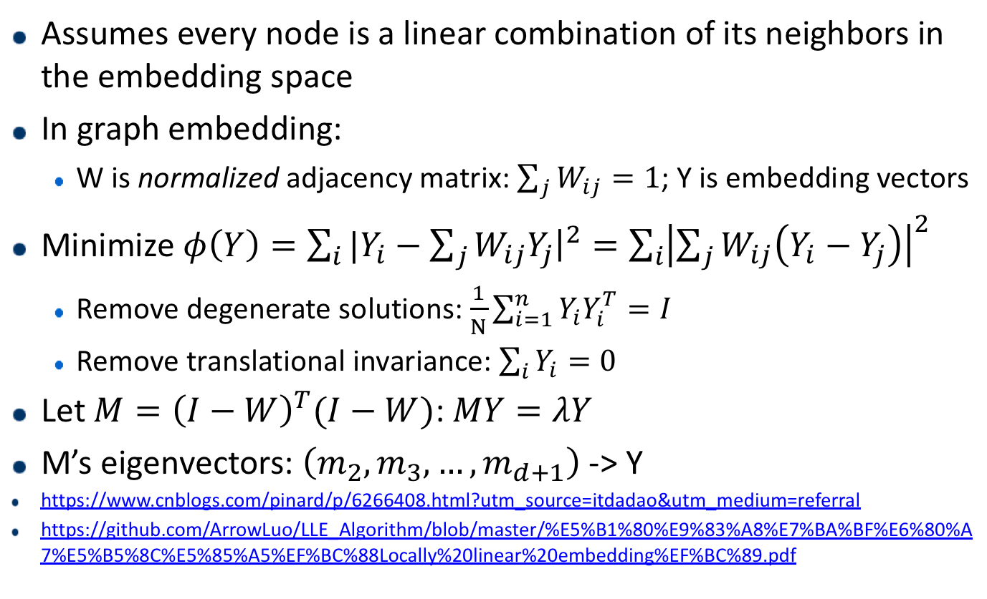
Locally Linear Embedding (LLE)
Assumes every node is a linear combination of its neighbors in the embedding space
In graph embedding:
W is normalized adjacency matrix: $\sum_{j}{W_{ij}}=1$; Y is embedding vectors
Minimize $φ\left(Y\right)=\sum_{i}{|Y_{i}−\sum_{j}{W_{ij}Y_{j}{\left.​\right|}^{2}}}=\sum_{i}{{\left|\sum_{j}{W_{ij}\left(Y_{i}−Y_{j}\right)}\right|}^{2}}$
Remove degenerate solutions: $\frac{1}{N}\sum_{i=1}^{n}{Y_{i}Y_{i}^{T}}=I$
Remove translational invariance: $\sum_{i}{Y_{i}}=0$
Let $M={\left(I−W\right)}^{T}(I−W)$: $MY=λY$
M’s eigenvectors: $\left(m_{2},m_{3},…,m_{d+1}\right)$ -> Y
https://www.cnblogs.com/pinard/p/6266408.html?utm_source=itdadao&utm_medium=referral
https://github.com/ArrowLuo/LLE_Algorithm/blob/master/%E5%B1%80%E9%83%A8%E7%BA%BF%E6%80%A7%E5%B5%8C%E5%85%A5%EF%BC%88Locally%20linear%20embedding%EF%BC%89.pdf
Notes:
将高维数据降维，同时保持局部特征
Graph embedding中的LLE略有区别：不需要从X计算W，直接从邻接矩阵得到W
防止产生退化解：限制方差
remove translational invariance（平移不变性）：限制均值（所有的y加常数，phi值不变）
变成特征值问题，取d+1个底部的特征向量
拉格朗日乘子法

Slide 10
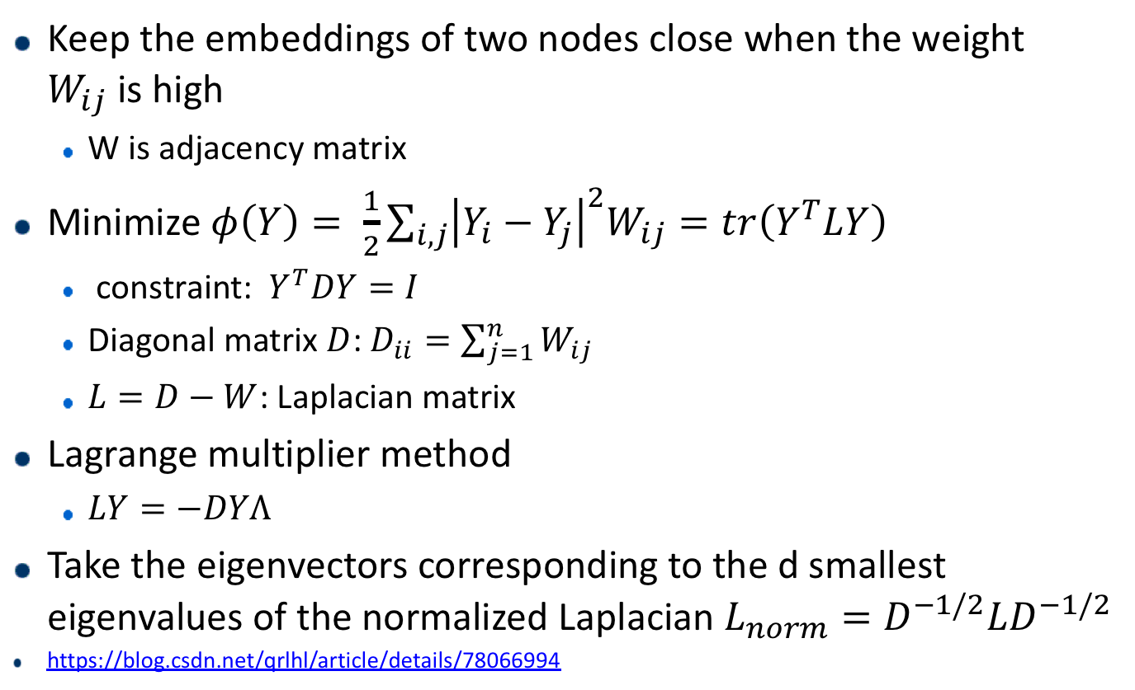
Laplacian Eigenmaps
Keep the embeddings of two nodes close when the weight $W_{ij}$is high
W is adjacency matrix
Minimize $φ\left(Y\right)= \frac{1}{2}\sum_{i,j}{{\left|Y_{i}−Y_{j}\right|}^{2}W_{ij}}=tr\left(Y^{T}LY\right)$
constraint: $Y^{T}DY=I$
Diagonal matrix $D$: $D_{ii}=\sum_{j=1}^{n}{W_{ij}}$
$L=D−W$: Laplacian matrix
Lagrange multiplier method
$LY=−DYΛ$
Take the eigenvectors corresponding to the d smallest eigenvalues of the normalized Laplacian $L_{norm}=D^{−1/2}LD^{−1/2}$
https://blog.csdn.net/qrlhl/article/details/78066994
Notes:
Eigenmaps 特征映射
W是邻接矩阵，值越大点越相似
D是度矩阵（对角矩阵），D_ii表示点度数
拉格朗日乘子法
Constraint保证优化问题有解

Slide 11
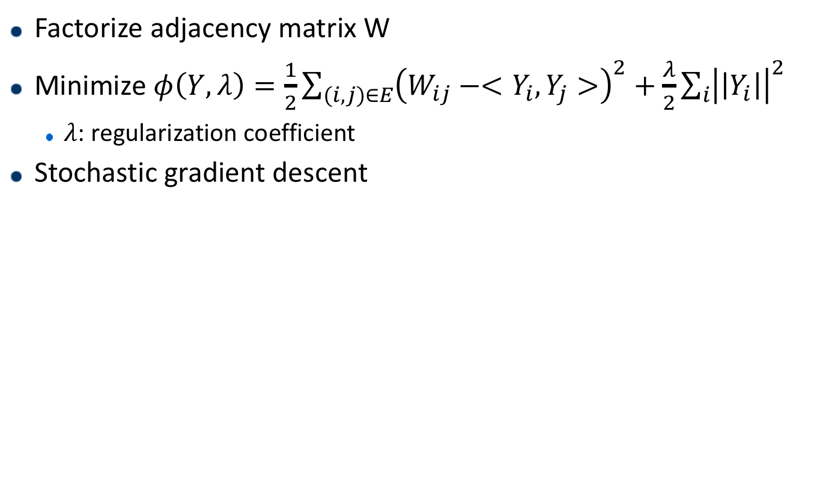
Graph Factorization
Factorize adjacency matrix W
Minimize $φ\left(Y, λ\right)=\frac{1}{2}\sum_{(i,j)∈E}{{\left(W_{ij}−<Y_{i},Y_{j}>\right)}^{2}+\frac{λ}{2}\sum_{i}{{\left|\left|Y_{i}\right|\right|}^{2}}}$
$λ$: regularization coefficient
Stochastic gradient descent
Notes:
让向量的内积尽量接近结点的相似度
Lambda 正则化系数
思想很接近：先找到某种方式表示向量的相似度，再找一个损失函数表示向量相似度和结点相似度的误差

Slide 12
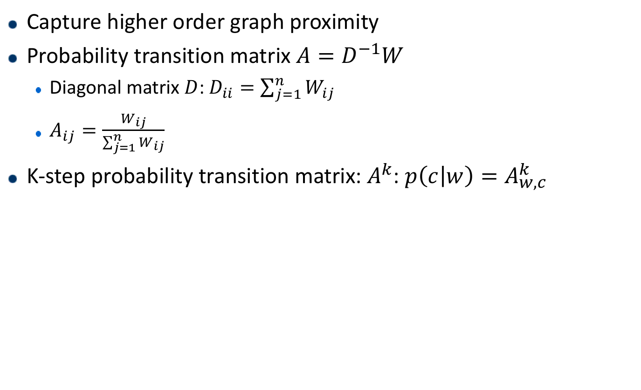
GraRep
Capture higher order graph proximity
Probability transition matrix $A=D^{−1}W$
Diagonal matrix $D$: $D_{ii}=\sum_{j=1}^{n}{W_{ij}}$
$A_{ij}=\frac{W_{ij}}{\sum_{j=1}^{n}{W_{ij}}}$
K-step probability transition matrix: $A^{k}$: $p\left(c | w\right)=A_{w,c}^{k}$
Notes:
D还是度数矩阵（对角矩阵），W是邻接矩阵
Ys, Yt类似于word2vec里的input vec， output vec

Slide 13
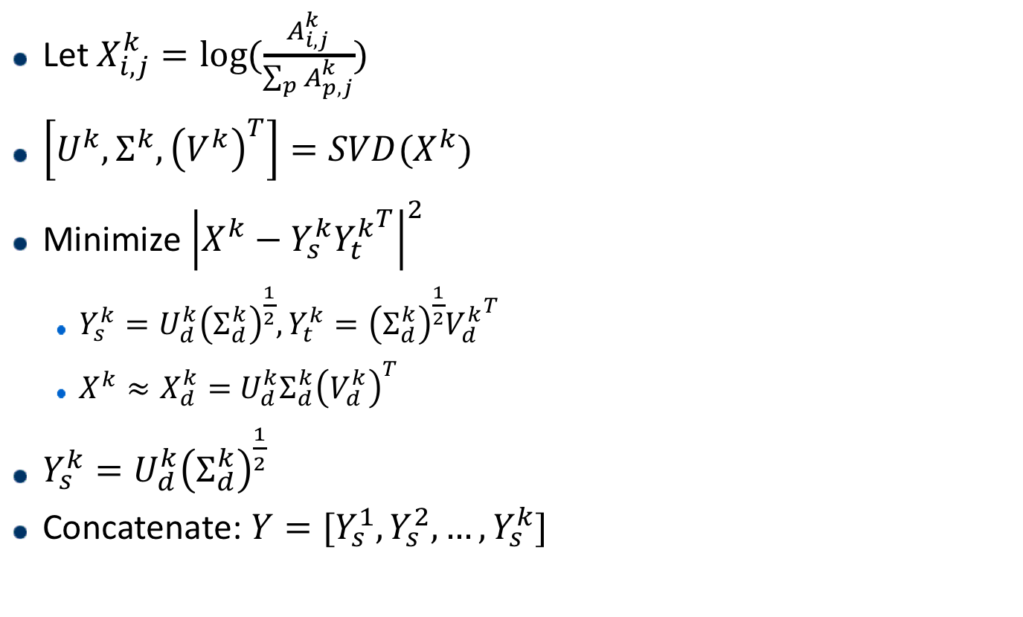
GraRep
Let $X_{i,j}^{k}=log⁡(\frac{A_{i,j}^{k}}{\sum_{p}{A_{p,j}^{k}}})$
$\left[U^{k},Σ^{k},{\left(V^{k}\right)}^{T}\right]=SVD(X^{k})$
Minimize ${\left|X^{k}−Y_{s}^{k}{Y_{t}^{k}}^{T}\right|}^{2}$
$Y_{s}^{k}=U_{d}^{k}{\left(Σ_{d}^{k}\right)}^{\frac{1}{2}},{Y_{t}^{k}=\left(Σ_{d}^{k}\right)}^{\frac{1}{2}}{V_{d}^{k}}^{T}$
$X^{k}≈X_{d}^{k}=$ $U_{d}^{k}Σ_{d}^{k}{\left(V_{d}^{k}\right)}^{T}$
$Y_{s}^{k}=U_{d}^{k}{\left(Σ_{d}^{k}\right)}^{\frac{1}{2}}$
Concatenate: $Y=[Y_{s}^{1},Y_{s}^{2},…, Y_{s}^{k}]$
Notes:
D还是度数矩阵（对角矩阵），W是邻接矩阵
Ys, Yt类似于word2vec里的input vec， output vec

Slide 14
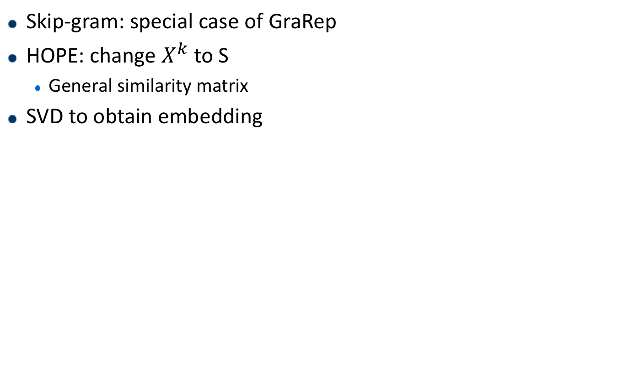
GraRep & HOPE
Skip-gram: special case of GraRep
HOPE: change $X^{k}$ to S
General similarity matrix
SVD to obtain embedding
Notes:
D还是度数矩阵（对角矩阵），W是邻接矩阵
Ys, Yt类似于word2vec里的input vec， output vec

Slide 15
Approaches
Factorization based methods
Random walk based methods
Deep learning based methods

Slide 16

Random Walk based Methods
Random walk rooted at vertex v: $W_{v}$
Stochastic process with random variables $W_{v}^{1}, W_{v}^{2},…W_{v}^{k}$
$W_{v}^{k+1}$is a vertex chosen at random from the neighbors of vertex $W_{v}^{k}$

Slide 17
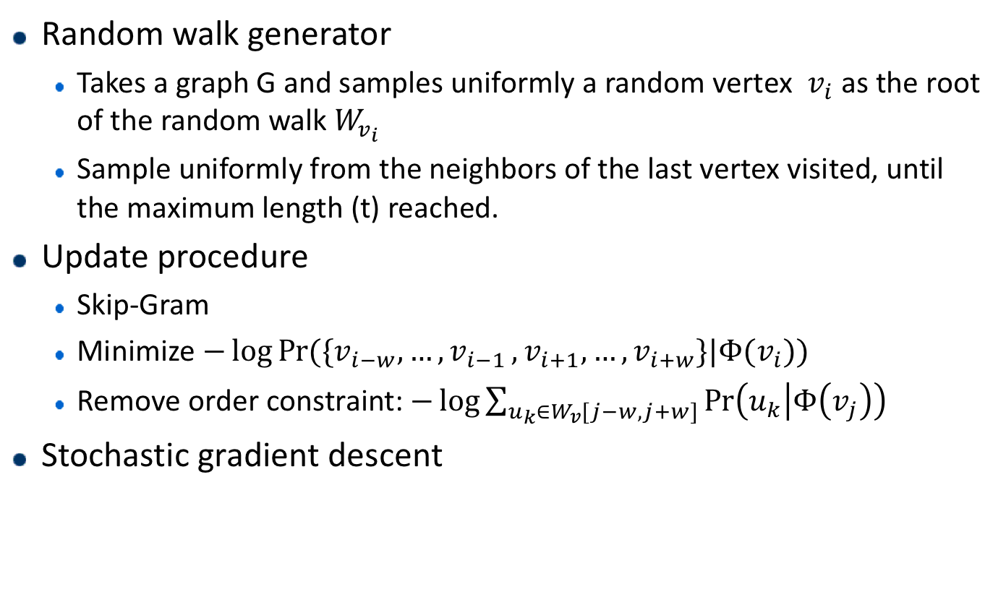
DeepWalk
Random walk generator
Takes a graph G and samples uniformly a random vertex $v_{i}$ as the root of the random walk $W_{v_{i}}$
Sample uniformly from the neighbors of the last vertex visited, until the maximum length (t) reached.
Update procedure
Skip-Gram
Minimize $−\log{\operatorname{Pr}{(\{v_{i−w},…, v_{i−1 },v_{i+1}, …, v_{i+w}\}|Φ(v_{i}))}}$
Remove order constraint: $−\log{\sum_{u_{k}∈W_{v}[j−w,j+w]}{\operatorname{Pr}\left(u_{k} | Φ\left(v_{j}\right)\right)}}$
Stochastic gradient descent
Notes:
用generator随机走t步，根据这t步更新embedding
将图序列化的过程
我的理解：只有第一次sample是uniform的，后面根据更新的distribution来sample

Slide 18
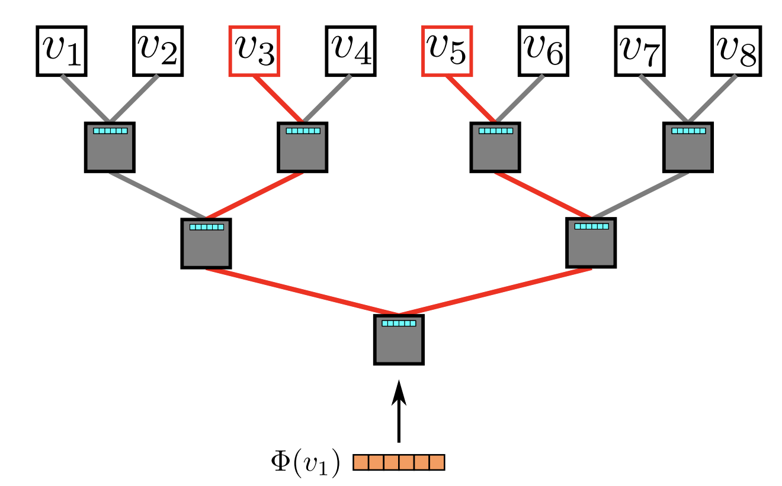
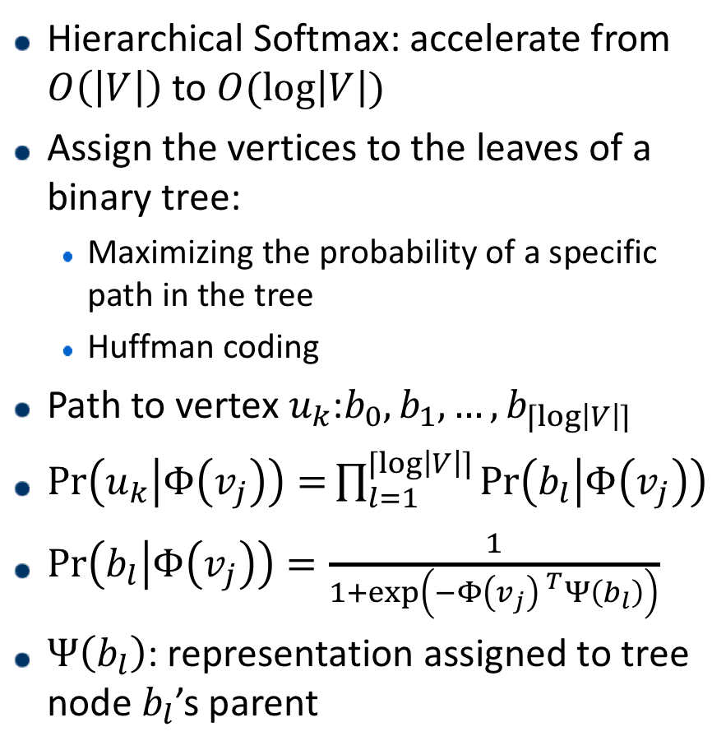
DeepWalk
Hierarchical Softmax: accelerate from $O\left(\left|V\right|\right)$ to $O(\log\left|V\right|)$
Assign the vertices to the leaves of a binary tree:
Maximizing the probability of a specific path in the tree
Huffman coding
Path to vertex $u_{k}$:$b_{0},b_{1},…, b_{⌈log\left|V\right|⌉}$
$\operatorname{Pr}\left(u_{k} | Φ\left(v_{j}\right)\right)=\prod_{l=1}^{⌈log\left|V\right|⌉}{\operatorname{Pr}\left(b_{l} | Φ\left(v_{j}\right)\right)}$
$\operatorname{Pr}\left(b_{l} | Φ\left(v_{j}\right)\right)=\frac{1}{1+\exp\left(−Φ\left(v_{j}\right) ^{T}Ψ\left(b_{l}\right)\right)}$
$Ψ\left(b_{l}\right)$: representation assigned to tree node $b_{l}$’s parent
Notes:
两个phi是一起优化的

Slide 19
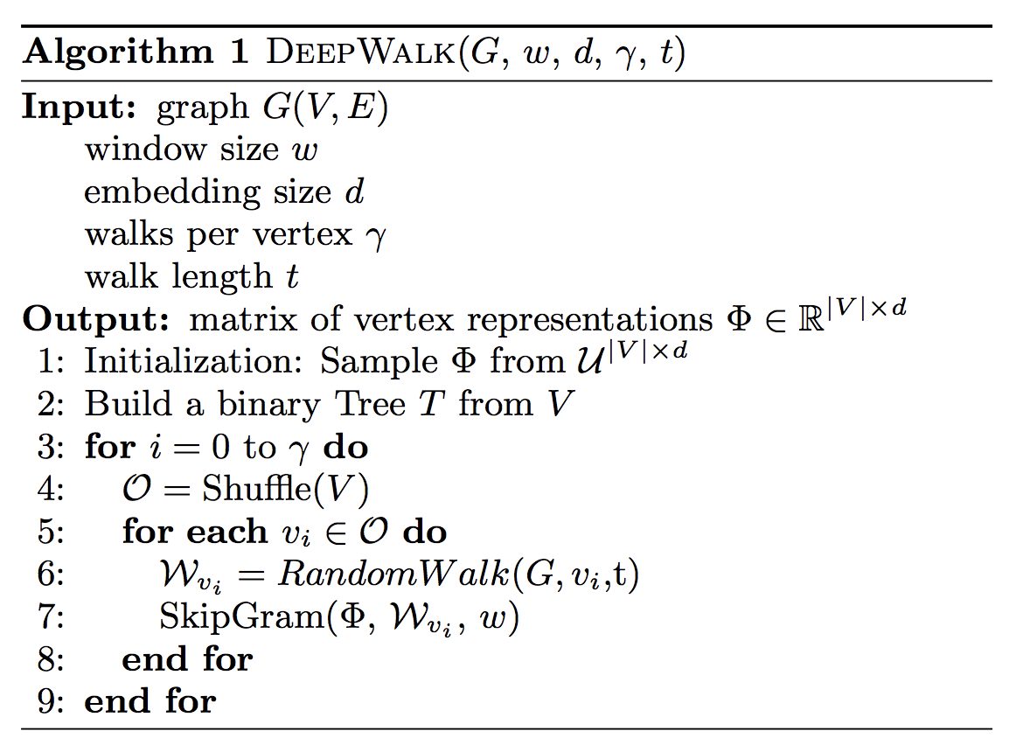
DeepWalk

Slide 20
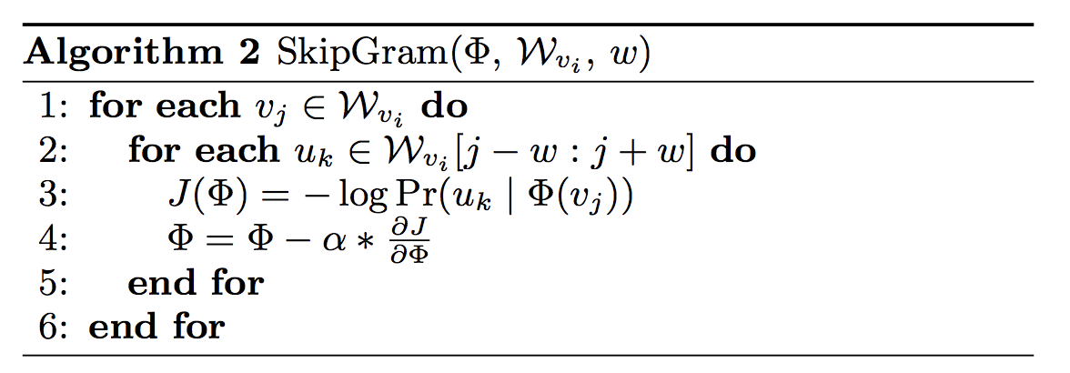
DeepWalk

Slide 21
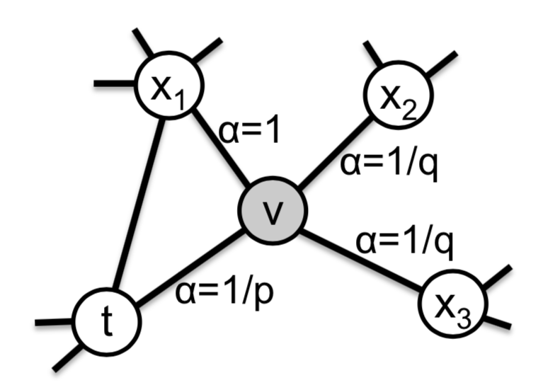
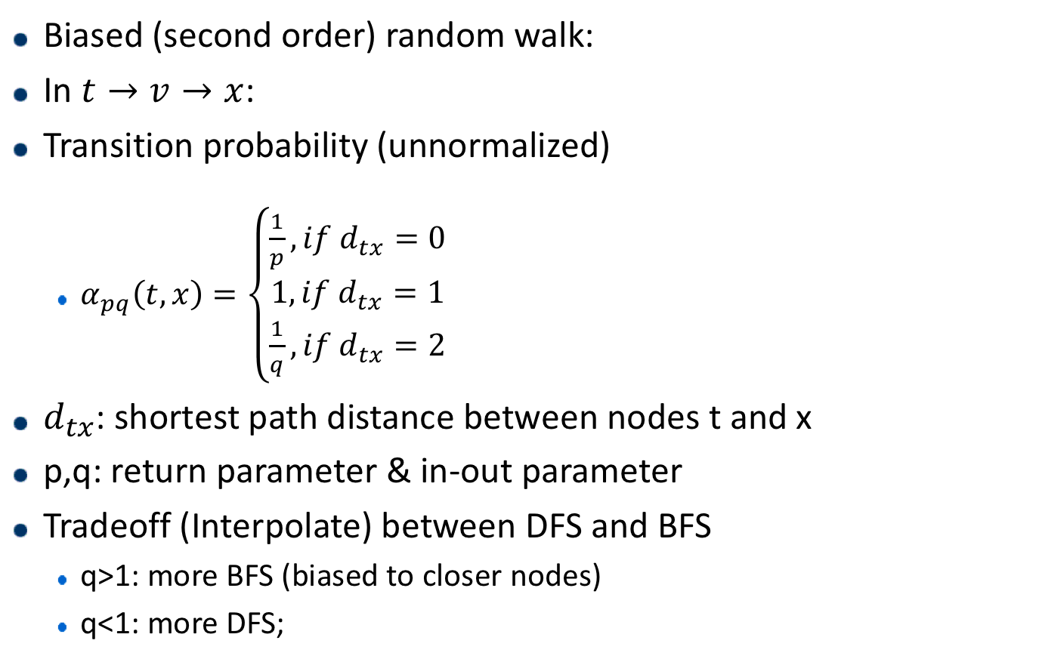
Node2Vec
Biased (second order) random walk:
In $t→v→x$:
Transition probability (unnormalized)
$α_{pq}\left(t,x\right)=\left\{\begin{aligned}\frac{1}{p}, if d_{tx}=0 \\ 1, if d_{tx}=1 \\ \frac{1}{q}, if d_{tx}=2\end{aligned}\right.$
$d_{tx}$: shortest path distance between nodes t and x
p,q: return parameter & in-out parameter
Tradeoff (Interpolate) between DFS and BFS
q>1: more BFS (biased to closer nodes)
q<1: more DFS;

Slide 22
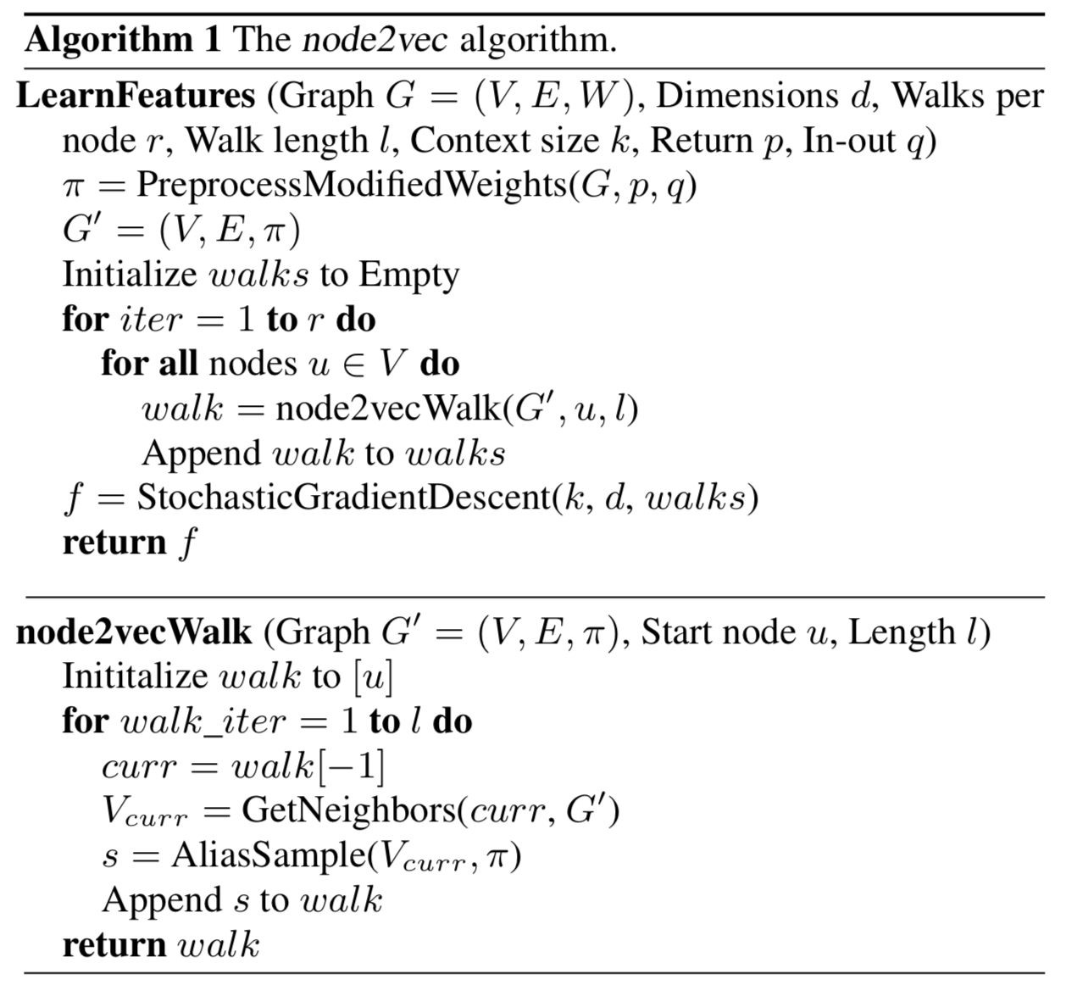
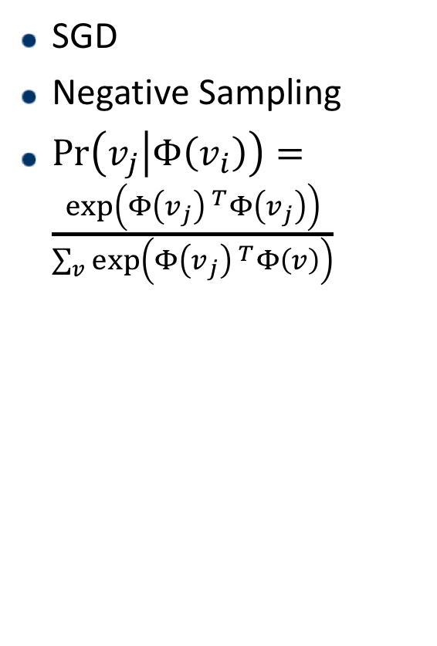
Node2Vec
SGD
Negative Sampling
$\operatorname{Pr}\left(v_{j} | Φ\left(v_{i}\right)\right)=\frac{\exp\left(Φ\left(v_{j}\right) ^{T}Φ\left(v_{j}\right)\right)}{\sum_{v}{\exp\left(Φ\left(v_{j}\right) ^{T}Φ\left(v\right)\right)}}$

Slide 23
Node2Vec
Trade-off between DFS and BFS
Community structure and structural equivalence between nodes
Higher quality, more informative embeddings

Slide 24
Hierarchical Representation Learning for Networks
DeepWalk and node2vec initialize randomly
Graph coarsening:
Collapse related nodes together into “supernodes”
Generates embedding of the coarsest graph
Initializes the node embeddings of the refined graph with the learned embedding
Propagates such embeddings through the hierarchy to obtain the embeddings of the original graph
Use DeepWalk, node2vec, etc.

Slide 25
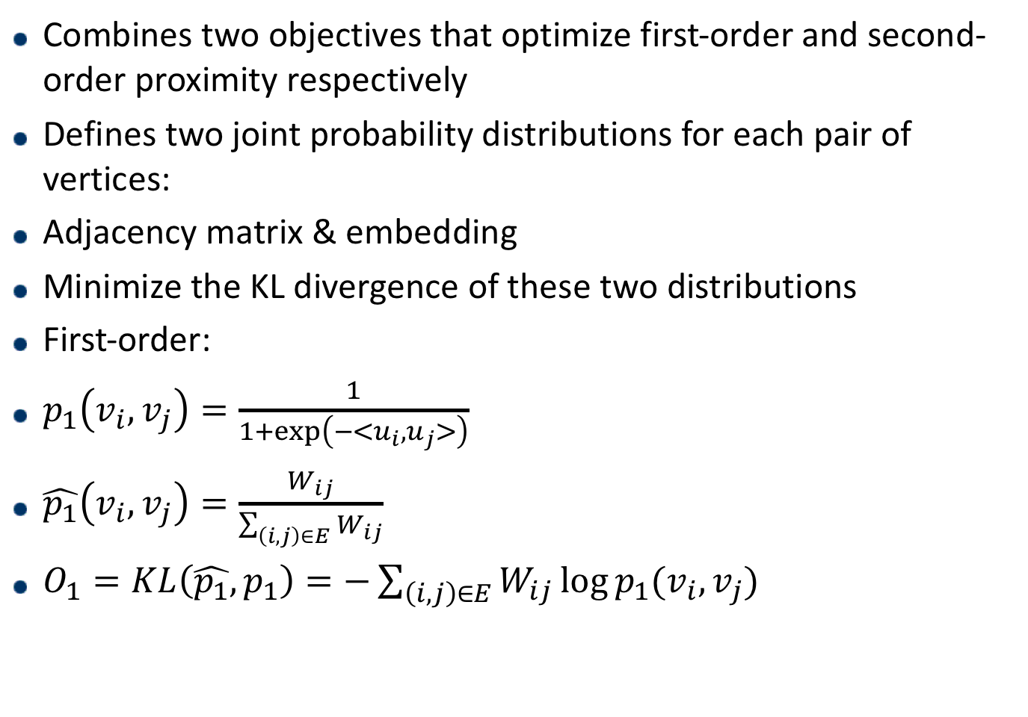
LINE: Large-scale Information Network Embedding
Combines two objectives that optimize first-order and second-order proximity respectively
Defines two joint probability distributions for each pair of vertices:
Adjacency matrix & embedding
Minimize the KL divergence of these two distributions
First-order:
$p_{1}\left(v_{i},v_{j}\right)=\frac{1}{1+\exp\left(−<u_{i},u_{j}>\right)}$
$\hat{p_{1}}\left(v_{i},v_{j}\right)=\frac{W_{ij}}{\sum_{\left(i,j\right)∈E}{W_{ij}}}$
$O_{1}=KL\left(\hat{p_{1}},p_{1}\right)=−\sum_{\left(i,j\right)∈E}{W_{ij}\log{p_{1}(v_{i},v_{j})}}$

Slide 26
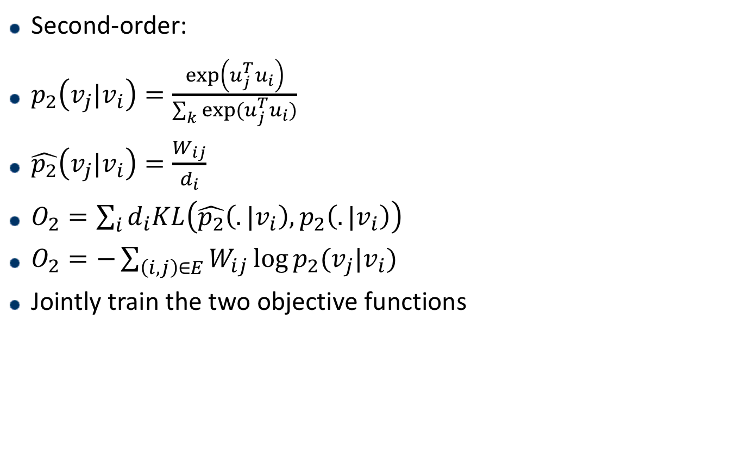
LINE: Large-scale Information Network Embedding
Second-order:
$p_{2}\left(v_{j}|v_{i}\right)=\frac{\exp\left(u_{j}^{T}u_{i}\right)}{\sum_{k}{exp⁡(u_{j}^{T}u_{i})}}$
$\hat{p_{2}}\left(v_{j}|v_{i}\right)=\frac{W_{ij}}{d_{i}}$
$O_{2}=\sum_{i}{d_{i}KL\left(\hat{p_{2}}\left(.|v_{i}\right),p_{2}\left(.|v_{i}\right)\right)}$
$O_{2}=−\sum_{\left(i,j\right)∈E}{W_{ij}\log{p_{2}(v_{j}|v_{i})}}$
Jointly train the two objective functions
Notes:
d是出度

Slide 27
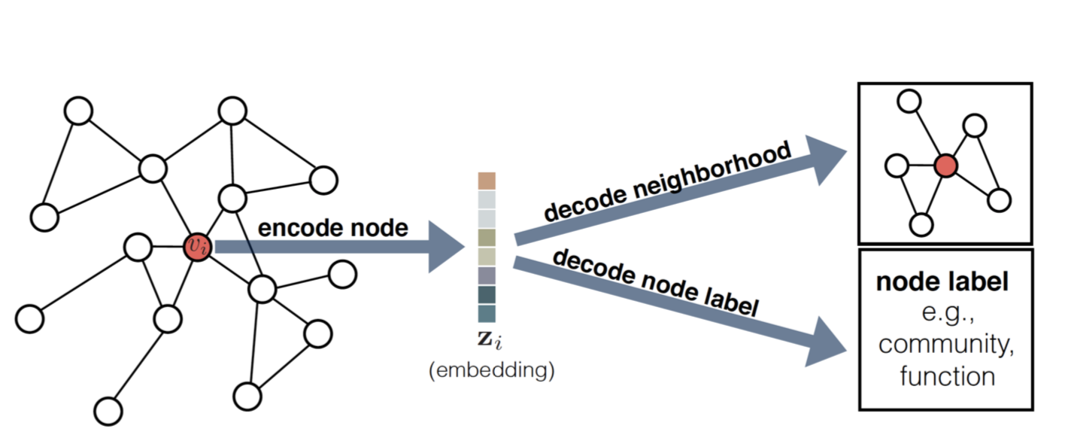
An encoder-decoder perspective

Slide 28
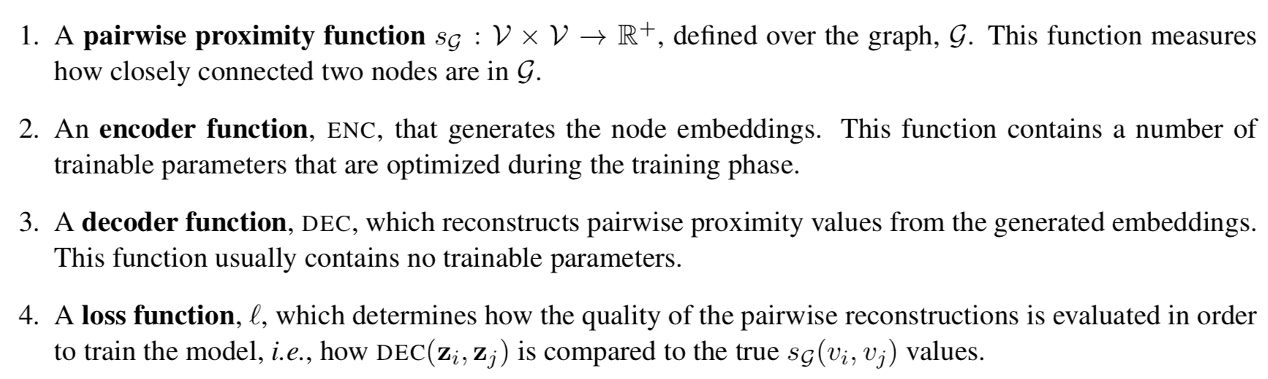
An encoder-decoder perspective

Slide 29
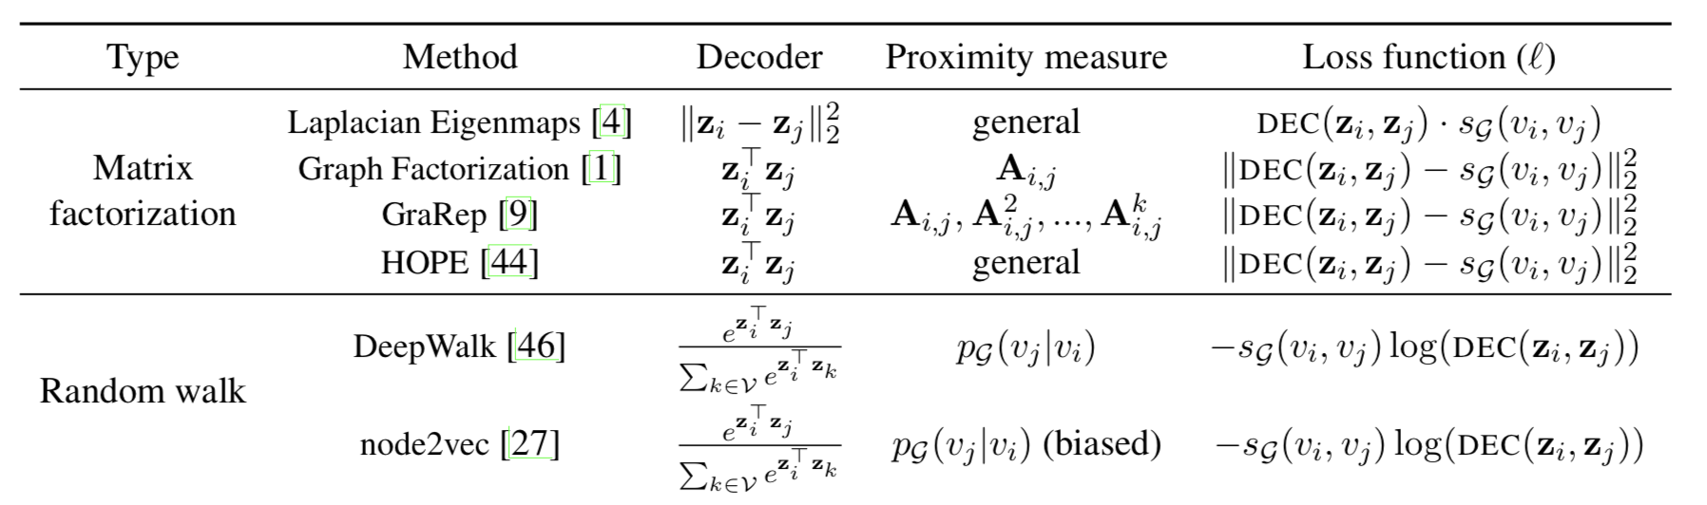
An encoder-decoder perspective

Slide 30
Drawbacks of Direct Encoding Approaches
No parameters are shared between: inefficient
parameter sharing can act as a regularization
the number of parameters necessarily grows as O(|V|)
Fails to leverage node attributes during encoding
e.g., user profiles on a social network, node’s position and role
Can only generate embeddings for nodes that were present during the training phase

Slide 31
Approaches
Factorization based methods
Random walk based methods
Deep learning based methods

Slide 32
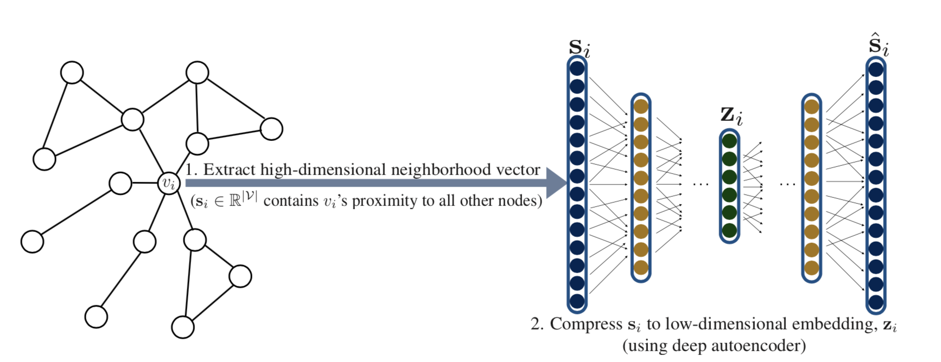
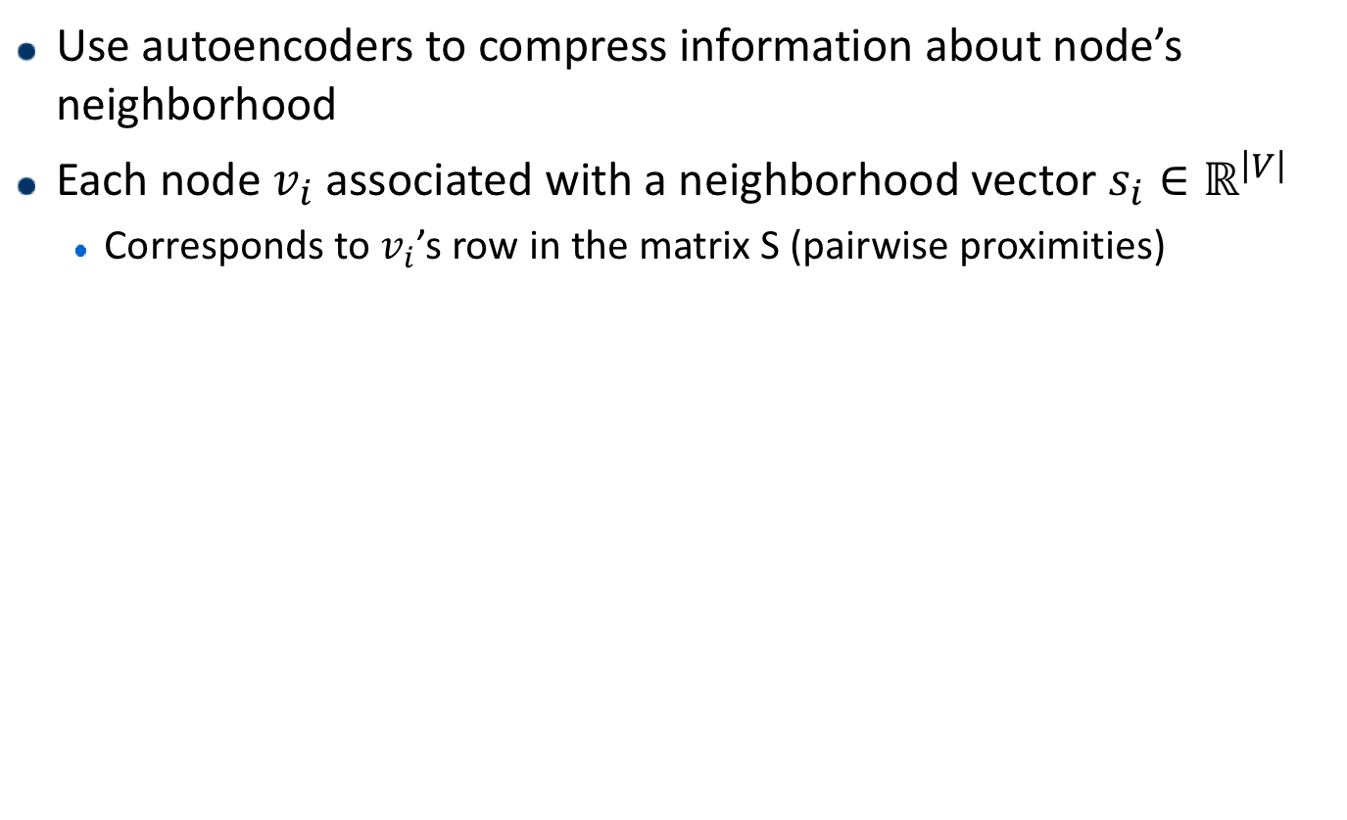
Neighborhood Autoencoder Methods
Use autoencoders to compress information about node’s neighborhood
Each node $v_{i}$ associated with a neighborhood vector $s_{i}∈ℝ^{\left|V\right|}$
Corresponds to $v_{i}$’s row in the matrix S (pairwise proximities)
Notes:
其他 Feedforward NN 关注的是 Output Layer 和错误率，而 AutoEncoder 关注的是 Hidden Layer；其次，普
AutoEncoder 其实是增强的 PCA：AutoEncoder 具有非线性变换单元，因此学出来的 Code 可能更精炼，对 Input 的表达能力更强通的 Feedforward NN 一般比较深，而 AutoEncoder 通常只有一层 Hidden Layer。
原始的 AutoEncoder 结构很简单：Input Layer、Hidden Layer、Output Layer。此网络的约束有：
Hidden Layer 的维度要远小于 Input Layer
Output 用于重构 Input，也即让误差L(Input, Output)最小
于是，可以用 Hidden Layer 中神经元组成的向量（这里我们称为 Code）来表示 Input，就达到了对 Input 压缩的效果。AutoEncoder 的训练方式就是普通的 BP。

Slide 33
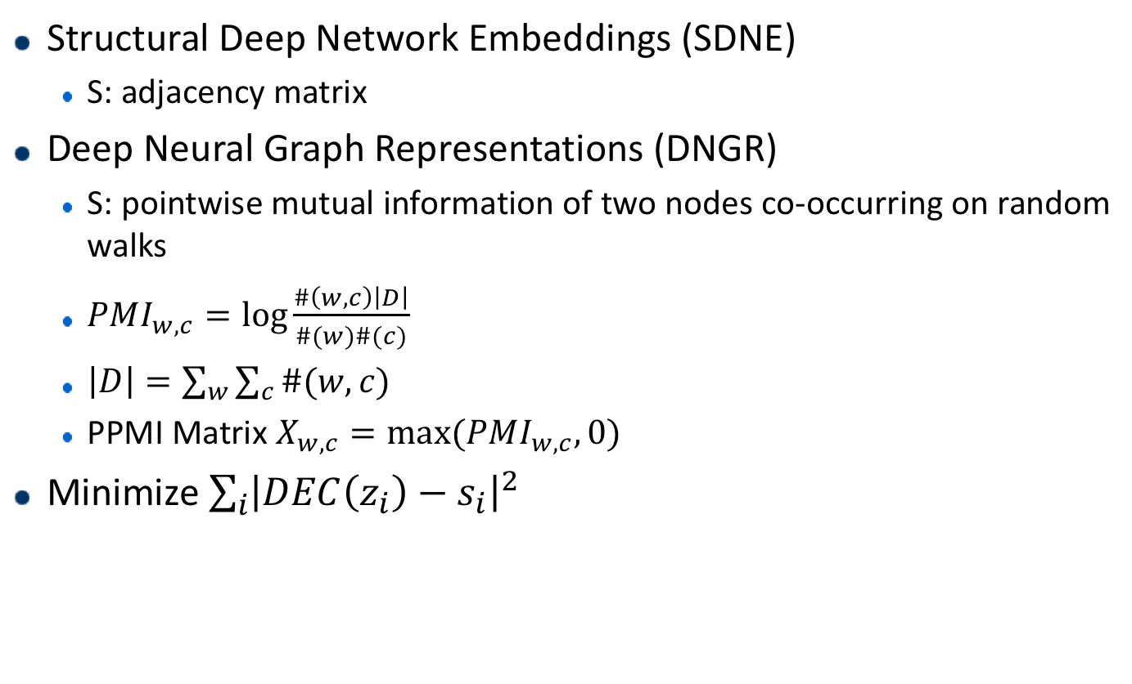
Neighborhood Autoencoder Methods
Structural Deep Network Embeddings (SDNE)
S: adjacency matrix
Deep Neural Graph Representations (DNGR)
S: pointwise mutual information of two nodes co-occurring on random walks
$PMI_{w,c}=\log{\frac{\#\left(w,c\right)\left|D\right|}{\#(w)\#(c)}}$
$\left|D\right|=\sum_{w}{\sum_{c}{\#(w,c)}}$
PPMI Matrix $X_{w,c}=\max{(PMI_{w,c}, 0)}$
Minimize $\sum_{i}{{\left|DEC\left(z_{i}\right)−s_{i}\right|}^{2}}$

Slide 34
Neighborhood Autoencoder Methods
Incorporate structural information about a node’s local neighborhood directly into the encoder as a form of regularization
Limitations
Input dimension is fixed at |V|:
The structure and size of the autoencoder is fixed
Cannot cope with evolving graphs, nor can they generalize across graph

Slide 35
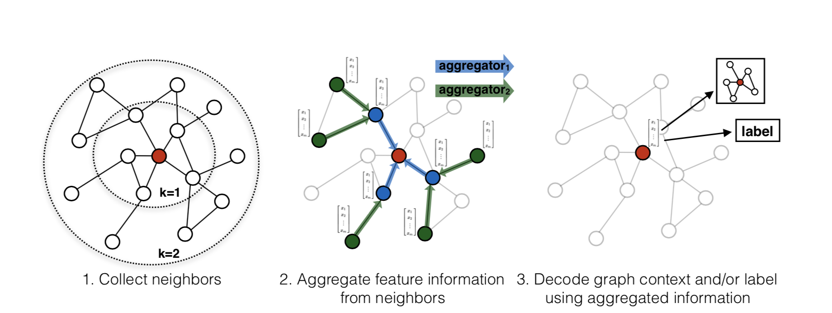
Neighborhood Aggregation Methods
Rely on node’s local neighborhood, features and attributes

Slide 36
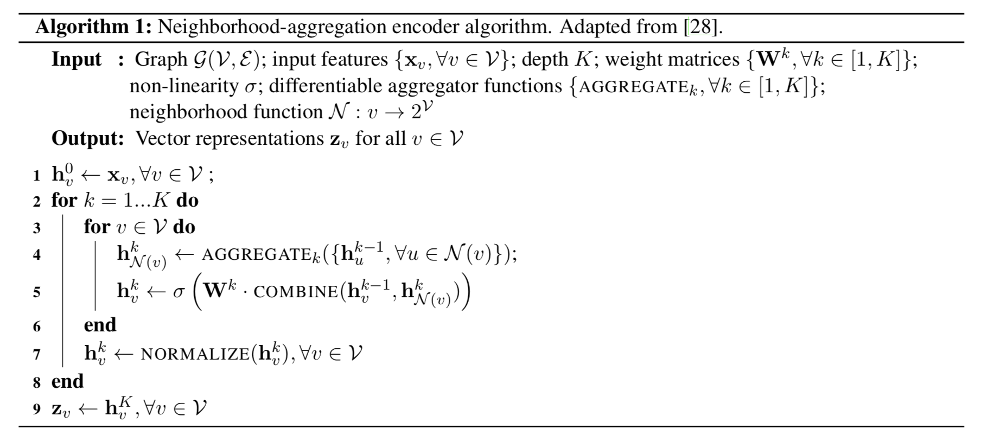
Neighborhood Aggregation Methods
Notes:
Embedding初始化时和输入的节点信息一致
每一轮迭代，aggregate邻居节点的embedding，结合之前的embedding，输入到dense网络
维度保持不变；压缩信息
随着迭代进行，embedding就包括了越来越远的信息

Slide 37
Graph Convolutional Networks
To be continued

Slide 38
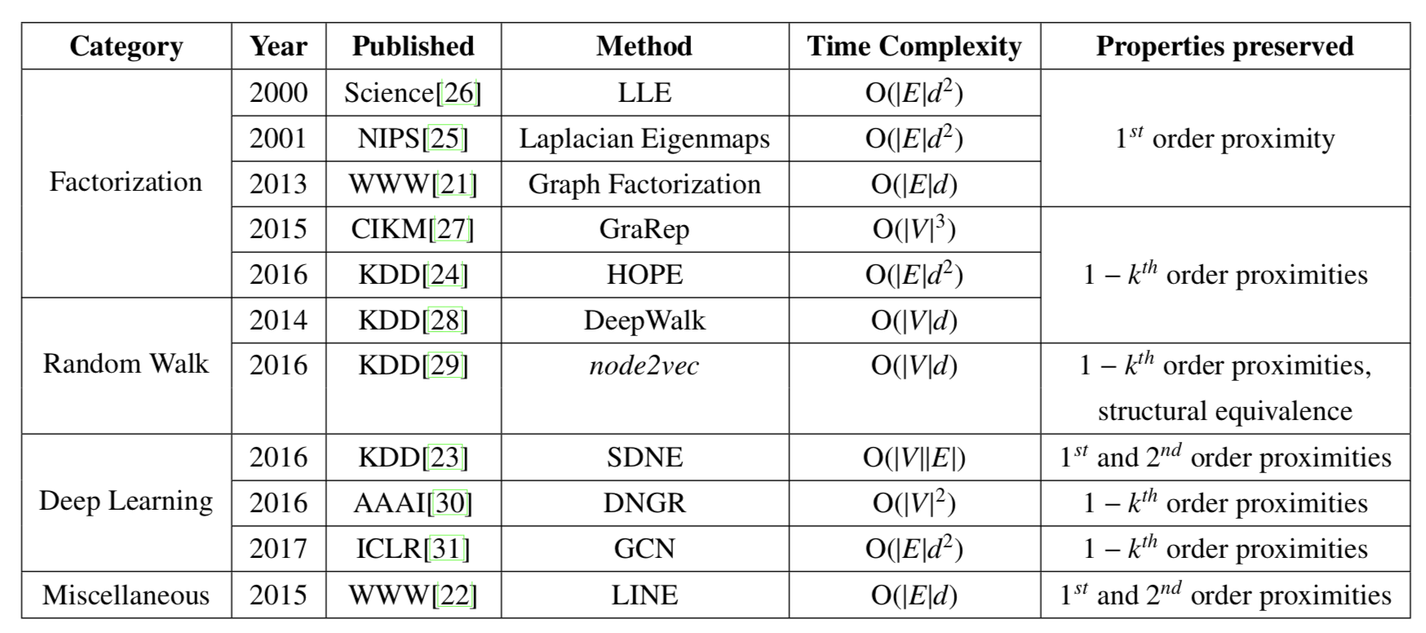
Summary

Slide 39
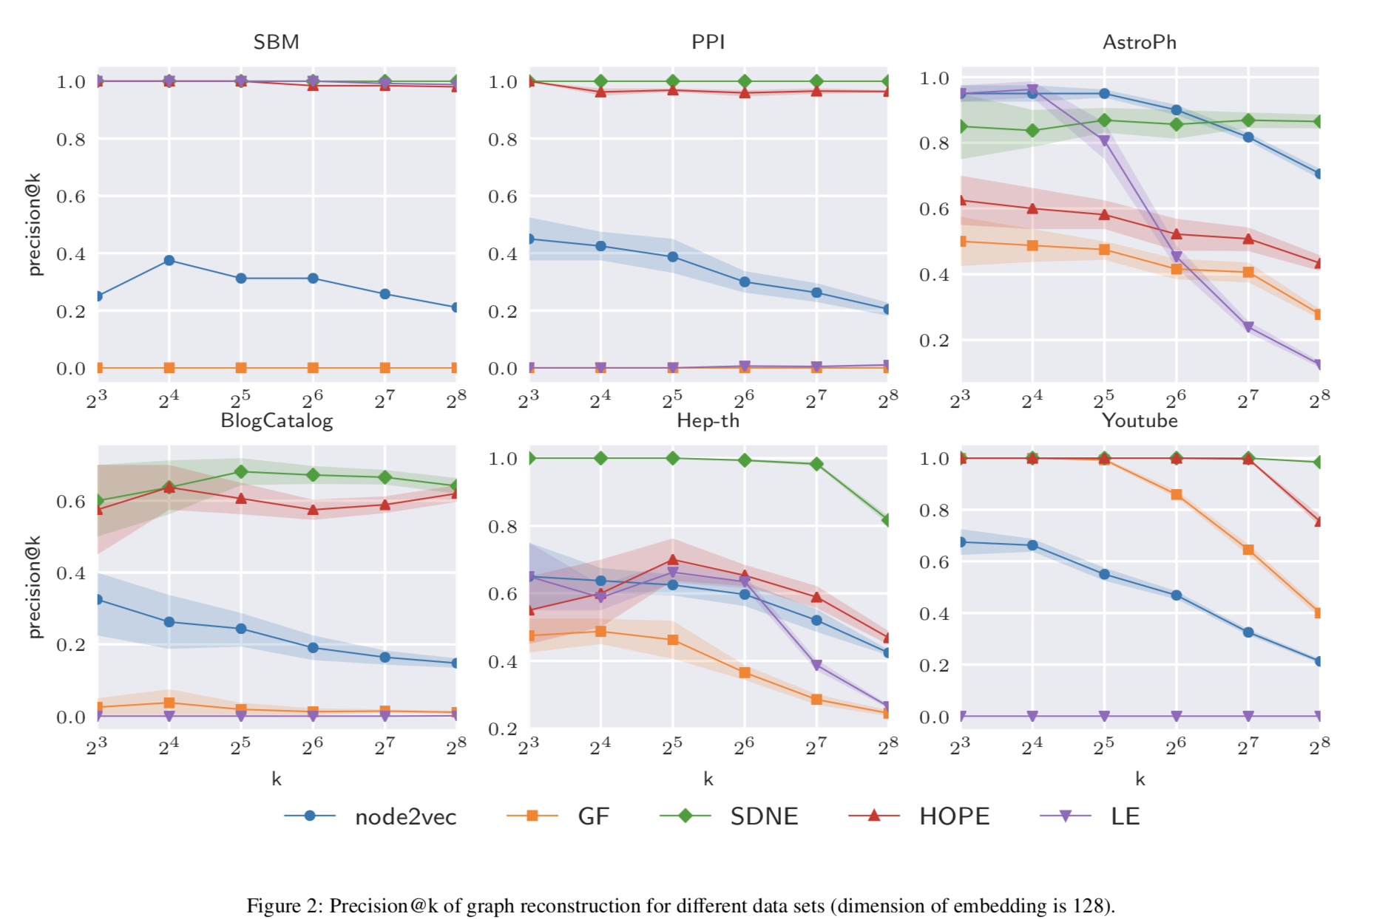
Experiments
Notes:
Generally，保存更高阶近似度信息的方法性能更好（node2vec, hope）
LE在sbm上效果好是因为数据集缺少高阶结构
SDNE效果好是因为学习复杂结构特征的能力
Node2vec在reconstruction上表现一般：非线性降维，产生非线性流形
HOPE效果好，没有额外参数

Slide 40
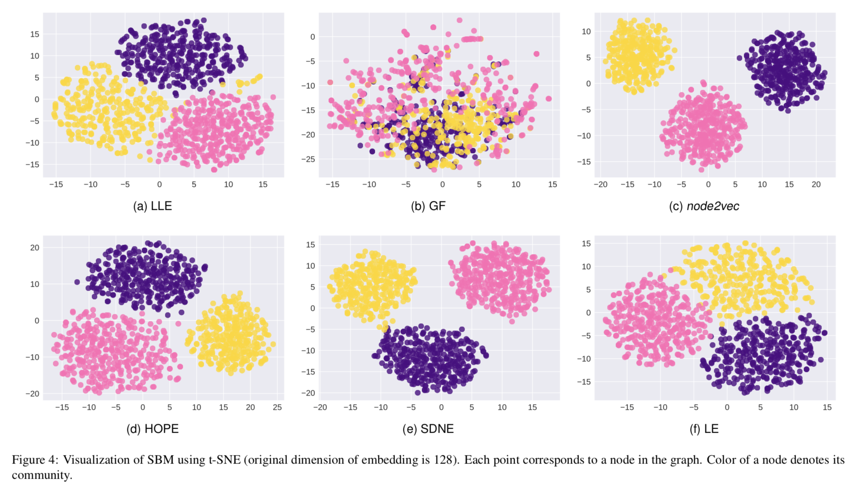
Experiments
Notes:
Node2vec：因为有BFS因素，局部结构信息，结构相同的点聚到一起
其他方法：k-hop，将临近的点聚到一起
HOPE SDNE 高阶近似度：很好的区分了community
LE GF LLE：部分地捕捉了community结构

Slide 41
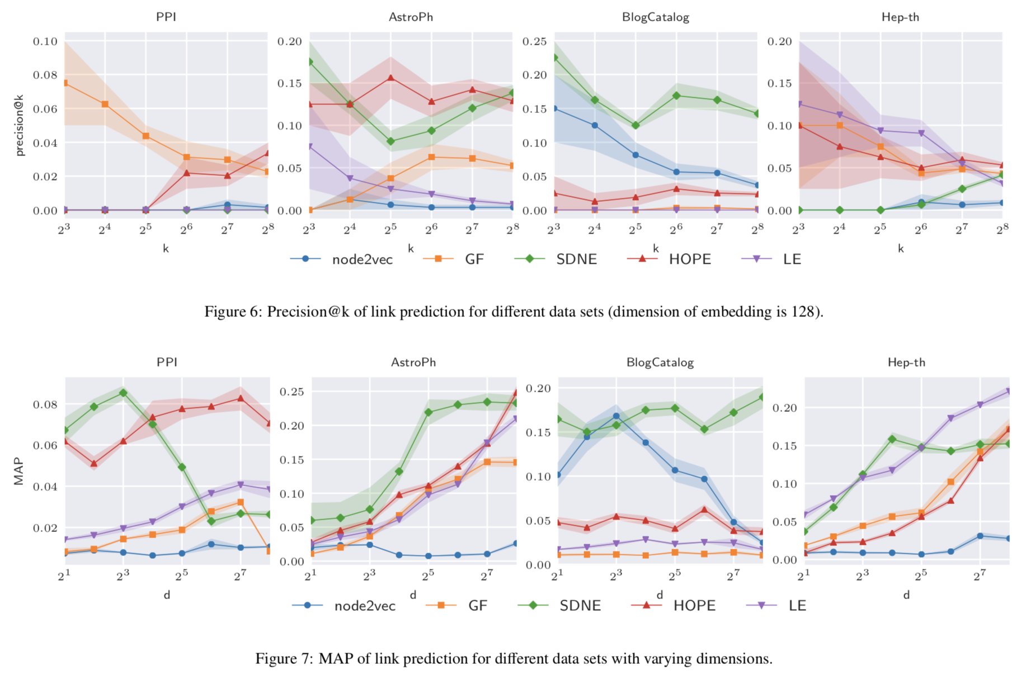
Experiments
Notes:
Node2vec在blogcatalog效果好，但是在其他效果差
Hope在所有效果都好：高阶近似度
Sdne在ppi效果一般L维度增大，性能降低
与数据集相关

Slide 42
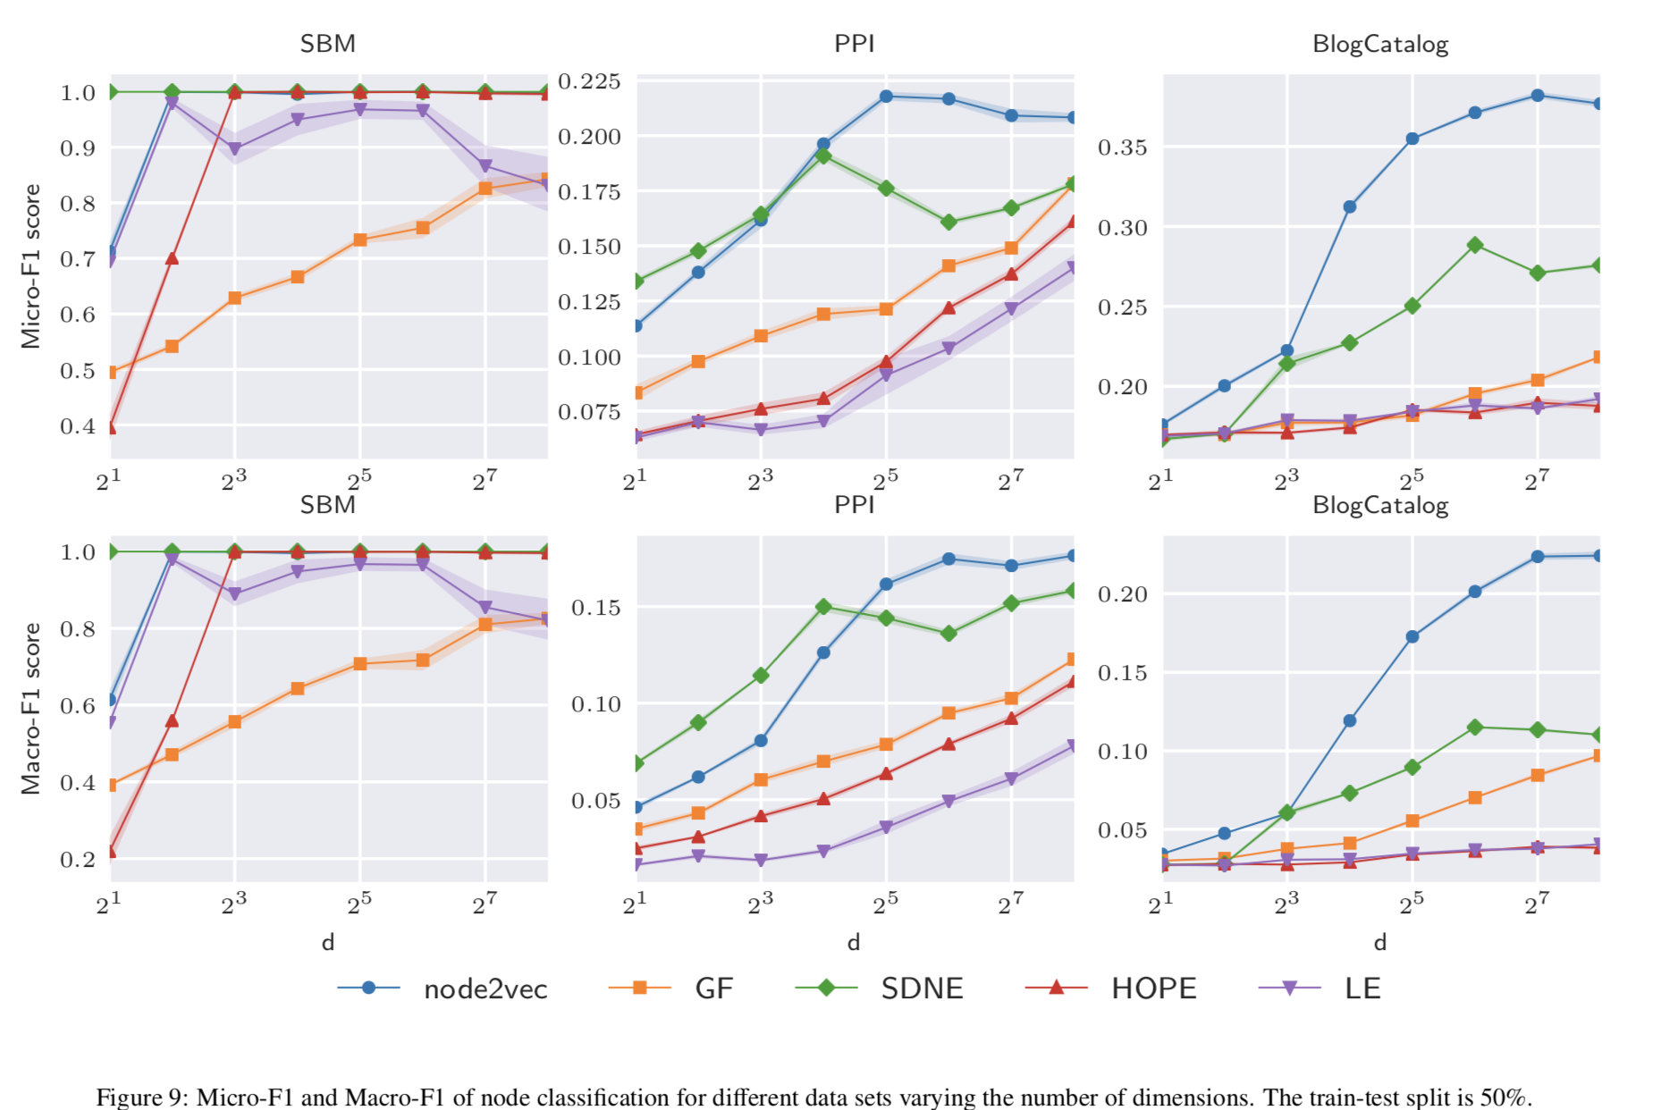
Experiments
Notes:
Node2vec效果好：结构信息
在sbm中，没有结构信息

Slide 43
References
Palash Goyal and Emilio Ferrara. Graph Embedding Techniques, Applications, and Performance: A Survey
William L. Hamilton, Rex Ying, Jure Leskovec. Representation Learning on Graphs: Methods and Applications
https://www.cnblogs.com/pinard/p/6266408.html
https://github.com/ArrowLuo/LLE_Algorithm/blob/master/%E5%B1%80%E9%83%A8%E7%BA%BF%E6%80%A7%E5%B5%8C%E5%85%A5%EF%BC%88Locally%20linear%20embedding%EF%BC%89.pdf
https://blog.csdn.net/qrlhl/article/details/78066994
S. T. Roweis, L. K. Saul, Nonlinear dimensionality reduction by locally linear embedding, Science 290 (5500) (2000) 2323–2326.
A. Ahmed, N. Shervashidze, S. Narayanamurthy, V. Josifovski, A. J. Smola, Distributed large-scale natural graph factorization, WWW 2013.
S. Cao, W. Lu, Q. Xu, Grarep: Learning graph representations with global structural information, CIKM 2015.
B. Perozzi, R. Al-Rfou, S. Skiena, Deepwalk: Online learning of social representations, KDD 2014.
A. Grover, J. Leskovec, node2vec: Scalable feature learning for networks, KDD 2016.
J. Tang, M. Qu, M. Wang, M. Zhang, J. Yan, Q. Mei, Line: Large- scale information network embedding, WWW 2015.
S. Cao, W. Lu, and Q. Xu. Deep neural networks for learning graph representations. AAAI 2016.
T. N. Kipf, M. Welling, Semi-supervised classification with graph convolutional networks. ICLR 2017.
Notes:
算法的设计，既考虑可解释性，也考虑实现可行性

